Slide 1
Analyzing Covid Pandemic
File created on: 5/10/2024 12:20:35 AM

Slide 2
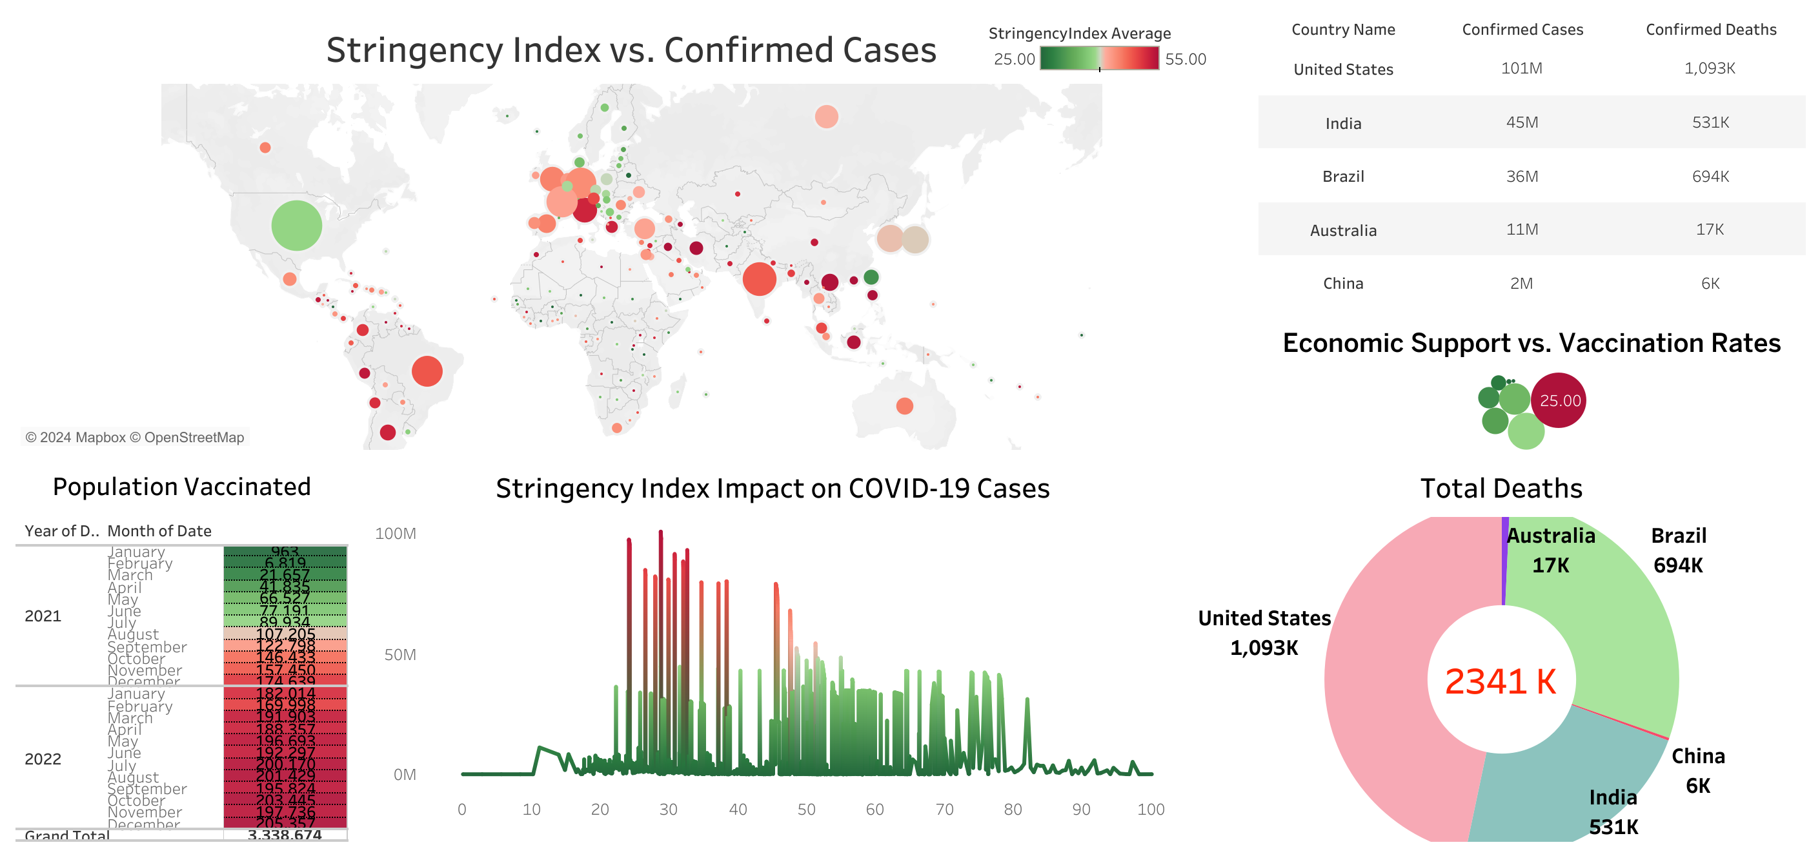

Slide 3
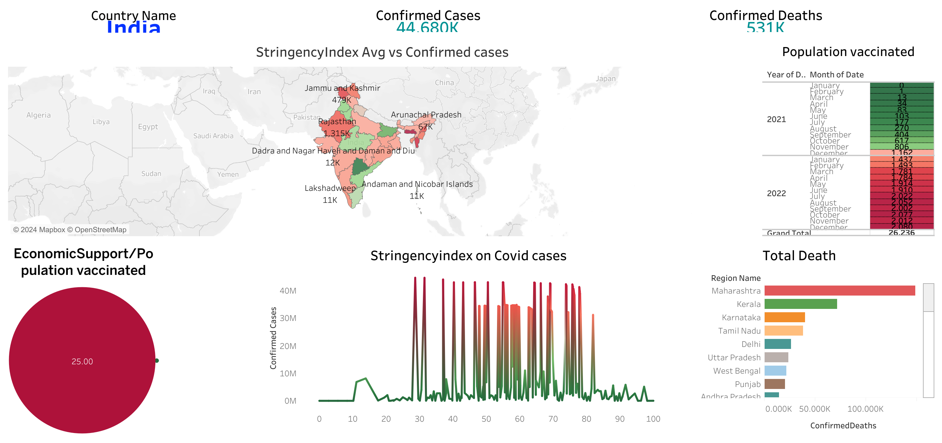

Slide 4
